Slide 1
Create Map-Based Apps

Slide 2
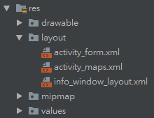
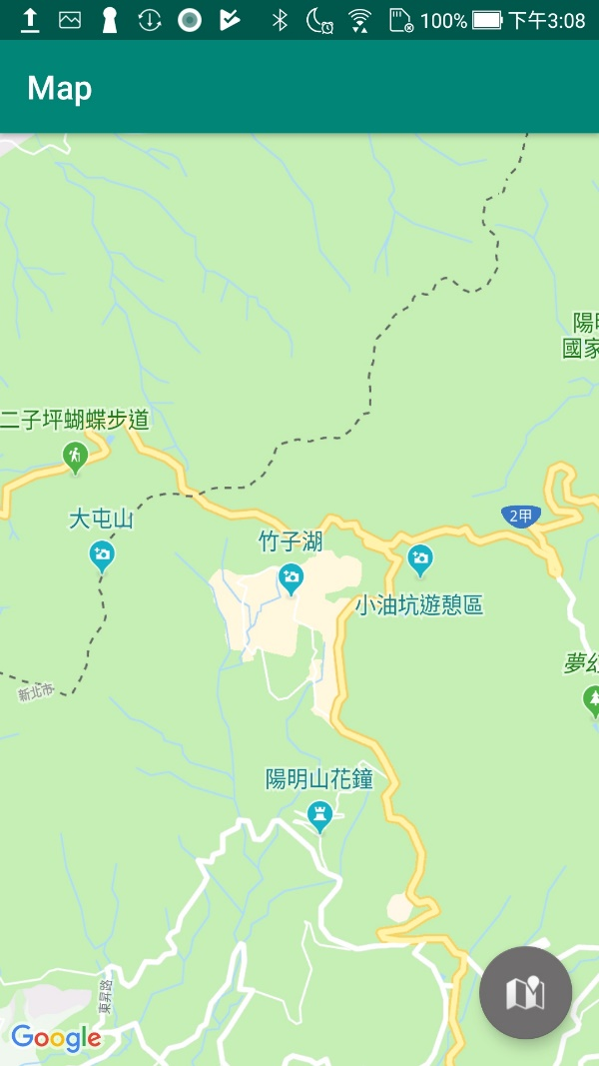
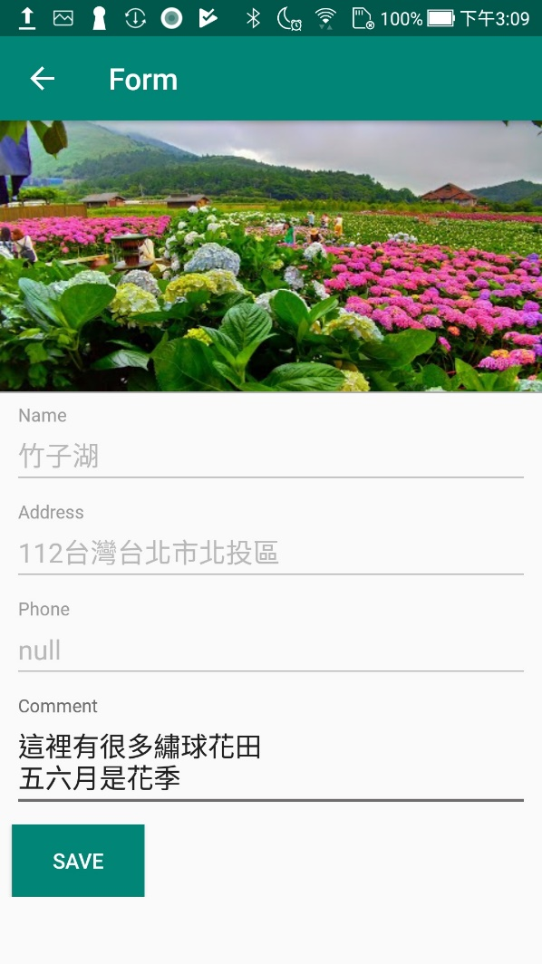
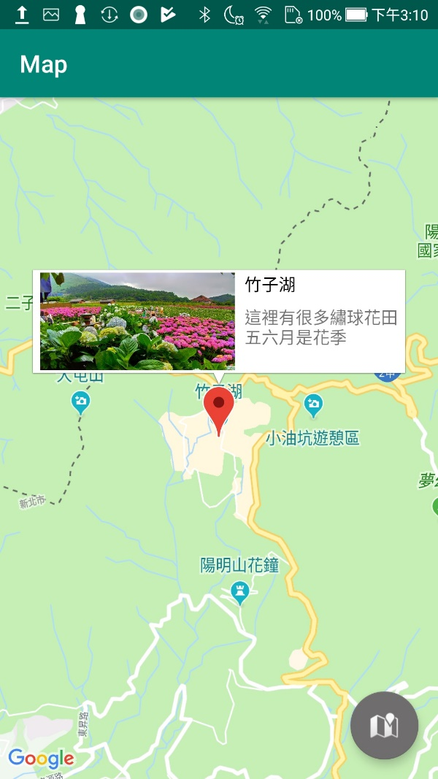

Slide 3
Get a Google maps API key
Steps:
Generate a keystore (optional)
Get SHA-1 Fingerprint
Create Google API project
Add certification
Get API key
Enable Maps SDK for Android
Set API key in Android project
Notes:
https://docs.microsoft.com/zh-tw/xamarin/android/platform/maps-and-location/maps/obtaining-a-google-maps-api-key?tabs=windows

Slide 4
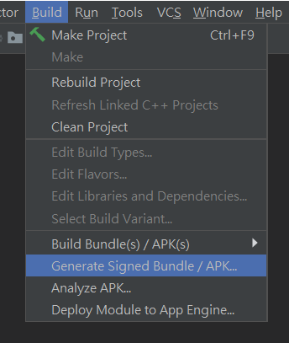
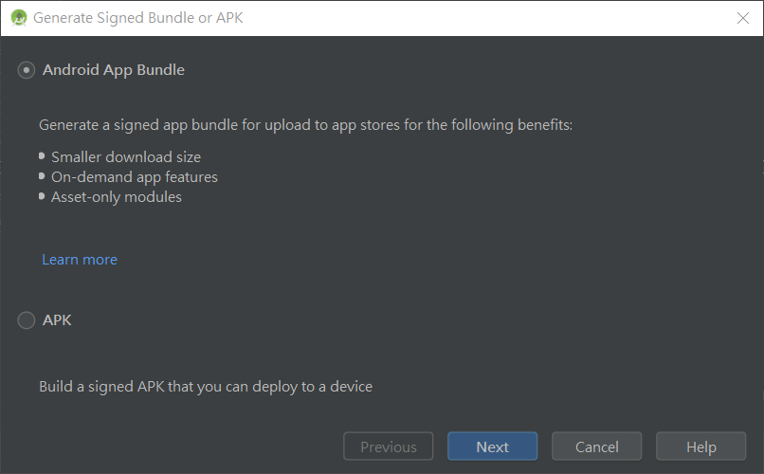
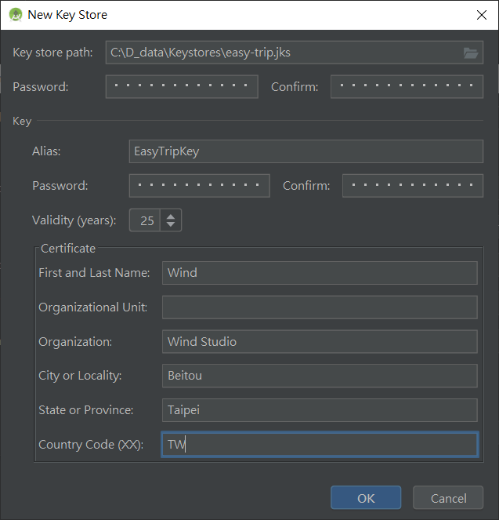
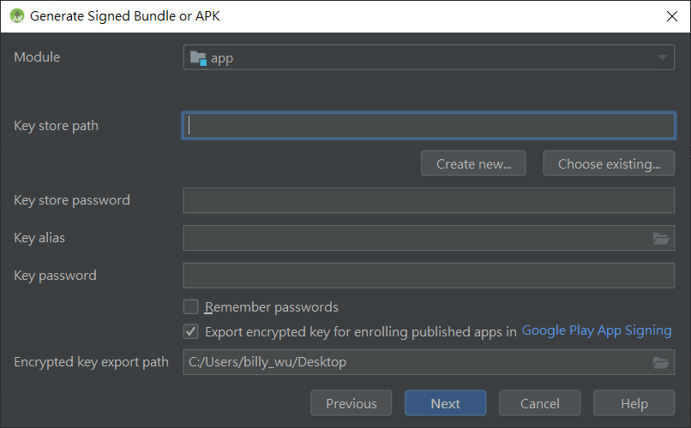
1. Generate a keystore (optional)
Notes:
https://docs.microsoft.com/zh-tw/xamarin/android/platform/maps-and-location/maps/obtaining-a-google-maps-api-key?tabs=windows

Slide 5
2. Get SHA-1 Fingerprint (1/3)
keytool
path (windows) → C:\Program Files\Java\jdk1.8.0_221\bin
Add this path to environment variable
Open cmd.exe & execute this command
keytool -list -v -keystore "%USERPROFILE%\.android\debug.keystore" -alias androiddebugkey -storepass android -keypass android
Change keystore for release mode
Notes:
https://docs.microsoft.com/zh-tw/xamarin/android/platform/maps-and-location/maps/obtaining-a-google-maps-api-key?tabs=windows

Slide 6
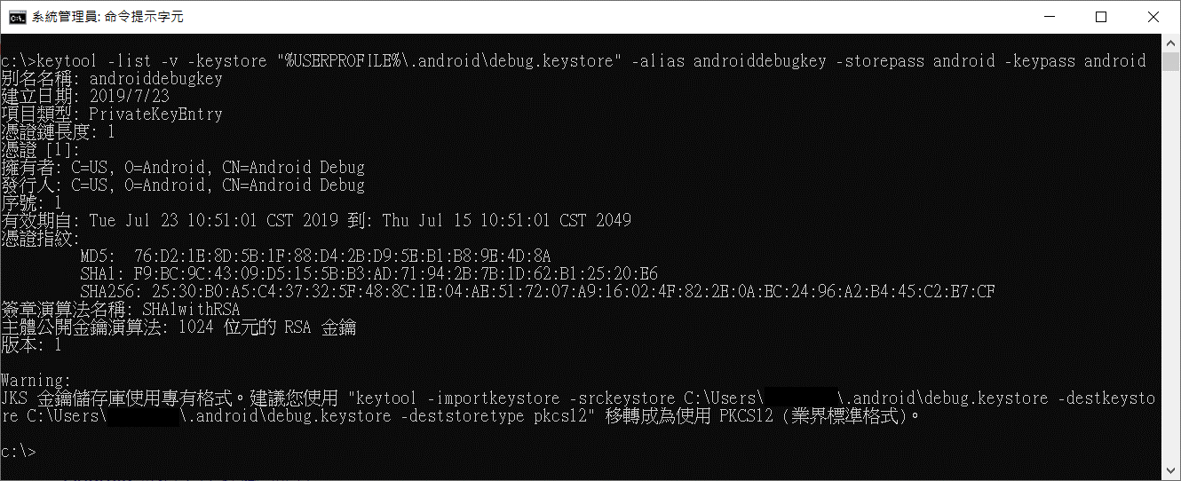
2. Get SHA-1 Fingerprint (2/3)

Slide 7
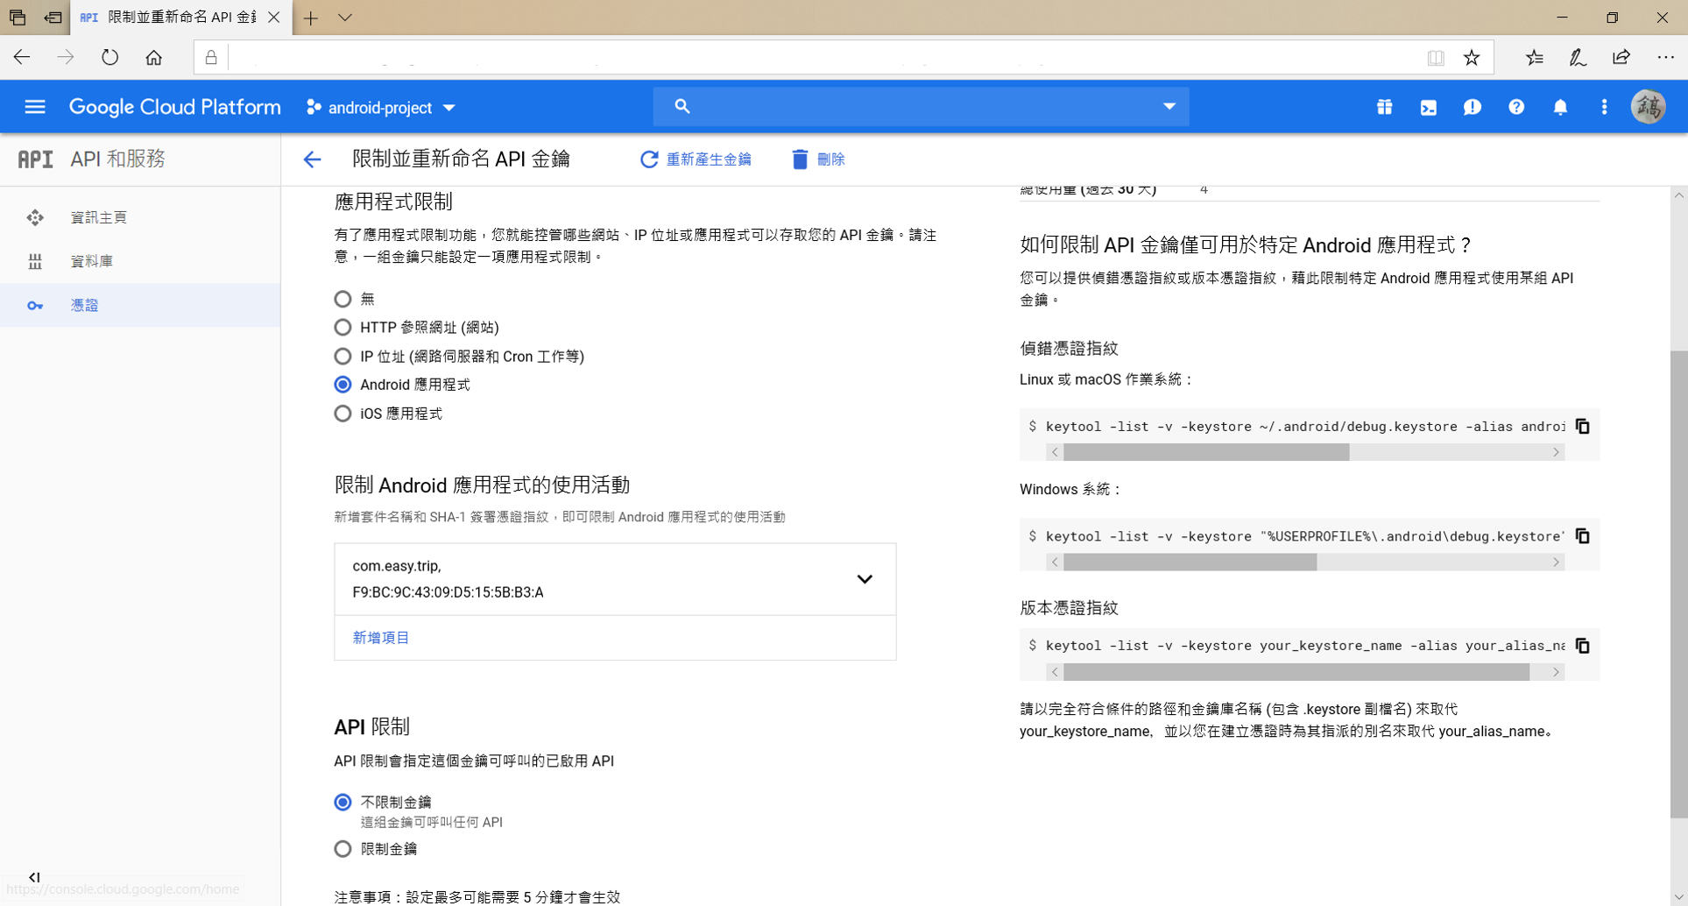
2. Get SHA-1 Fingerprint (3/3)
Notes:
https://docs.microsoft.com/zh-tw/xamarin/android/platform/maps-and-location/maps/obtaining-a-google-maps-api-key?tabs=windows

Slide 8
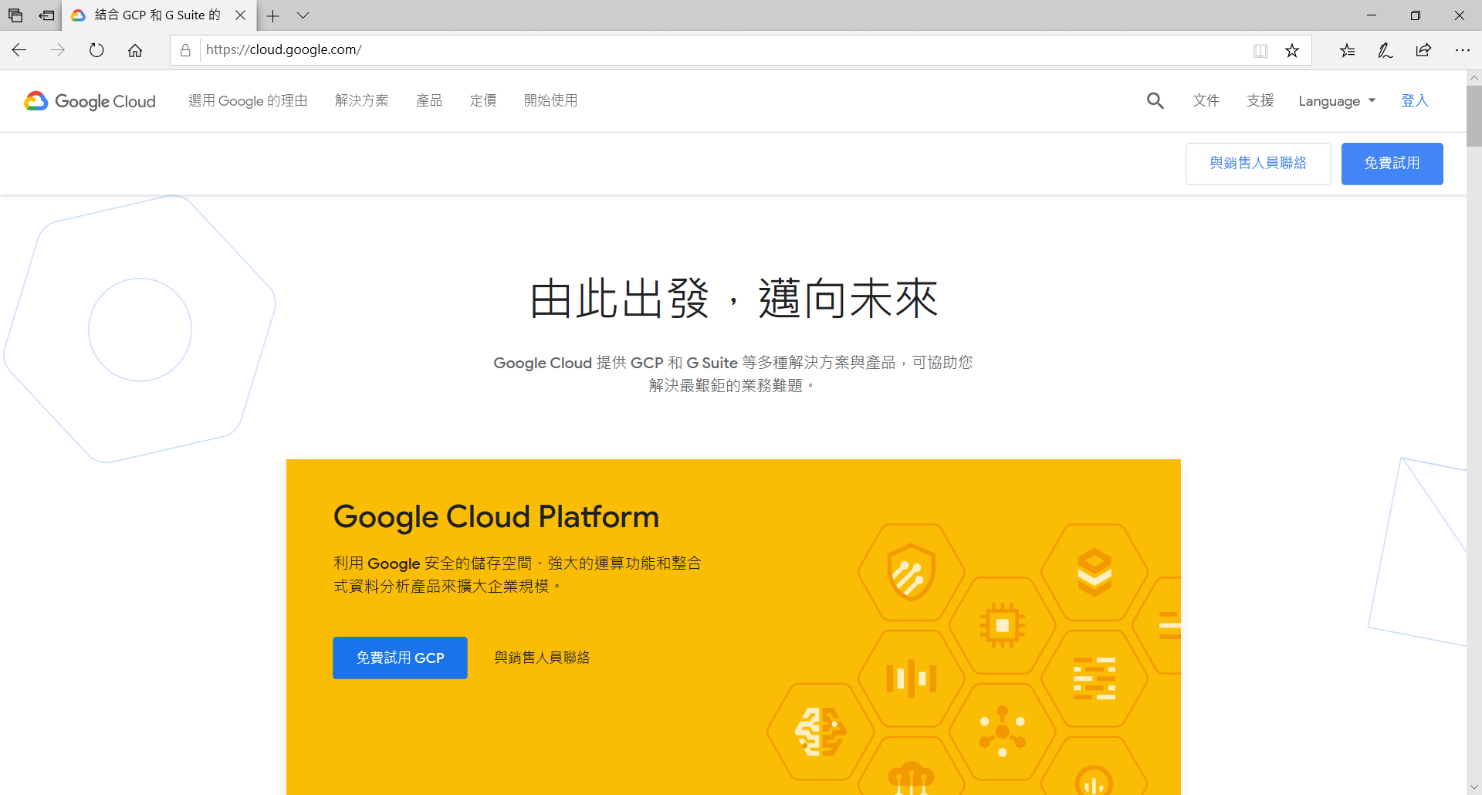
3. Create Google API project (1/2)
Browse to Google Cloud Platform and login

Slide 9

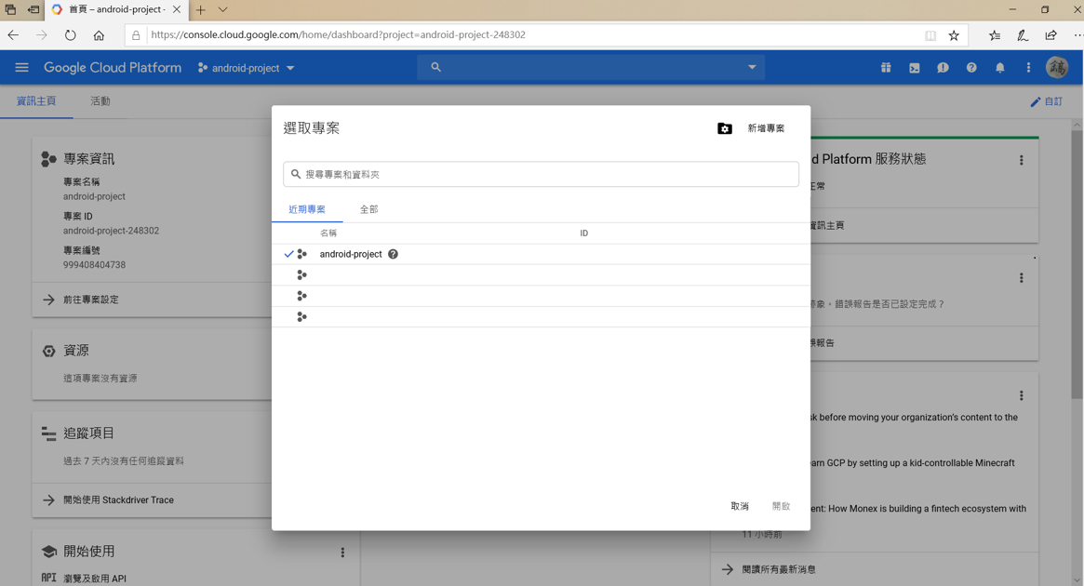
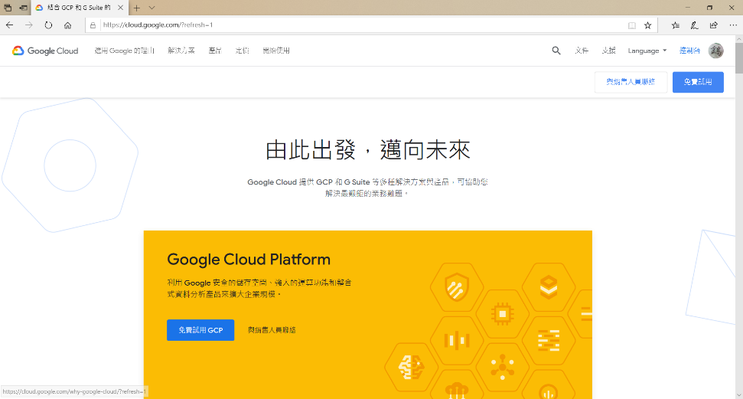
3. Create Google API project (2/2)
1. Login
3. Create project
2. Navigate to dashborad

Slide 10
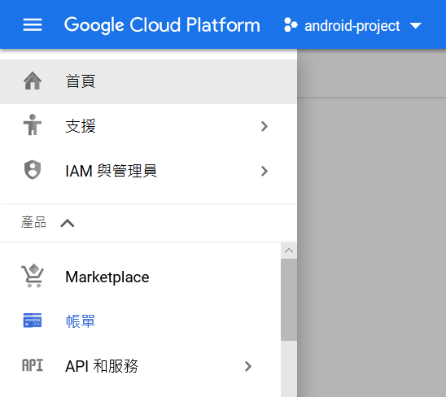
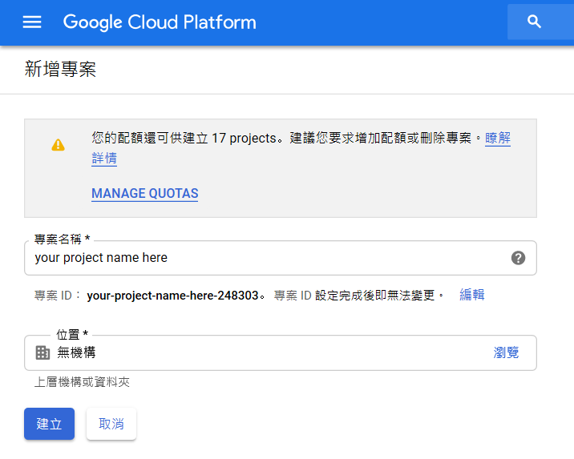
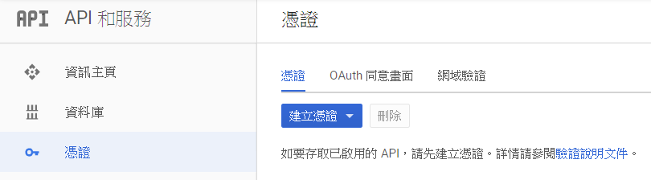
4. Add certification

Slide 11
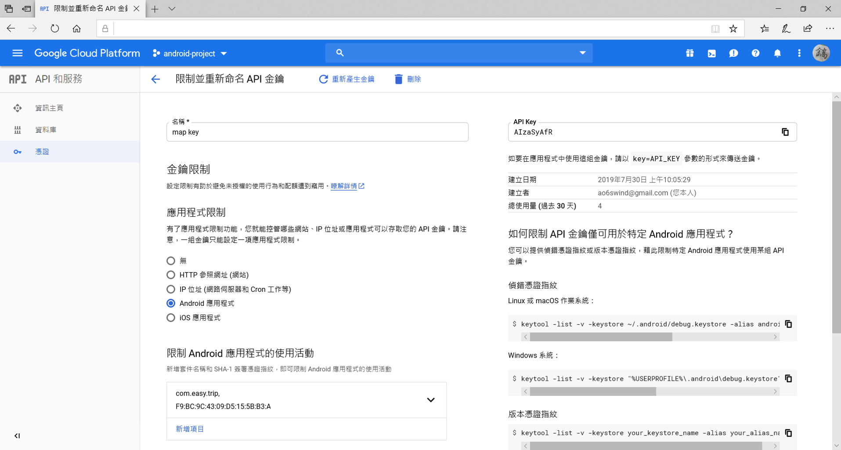
5. Get API key

Slide 12
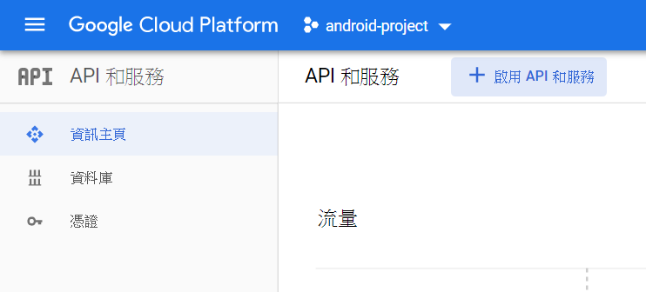
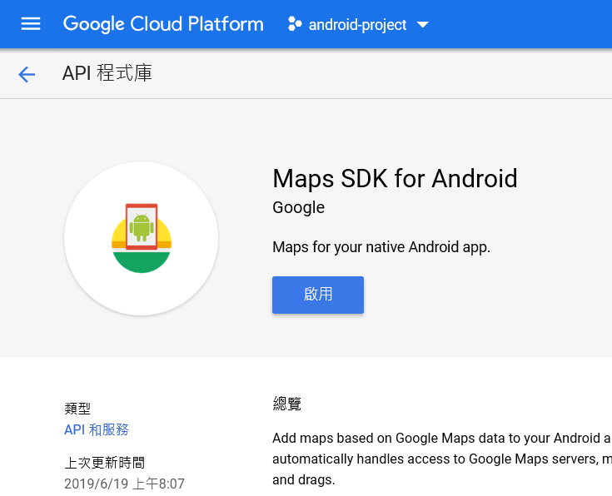
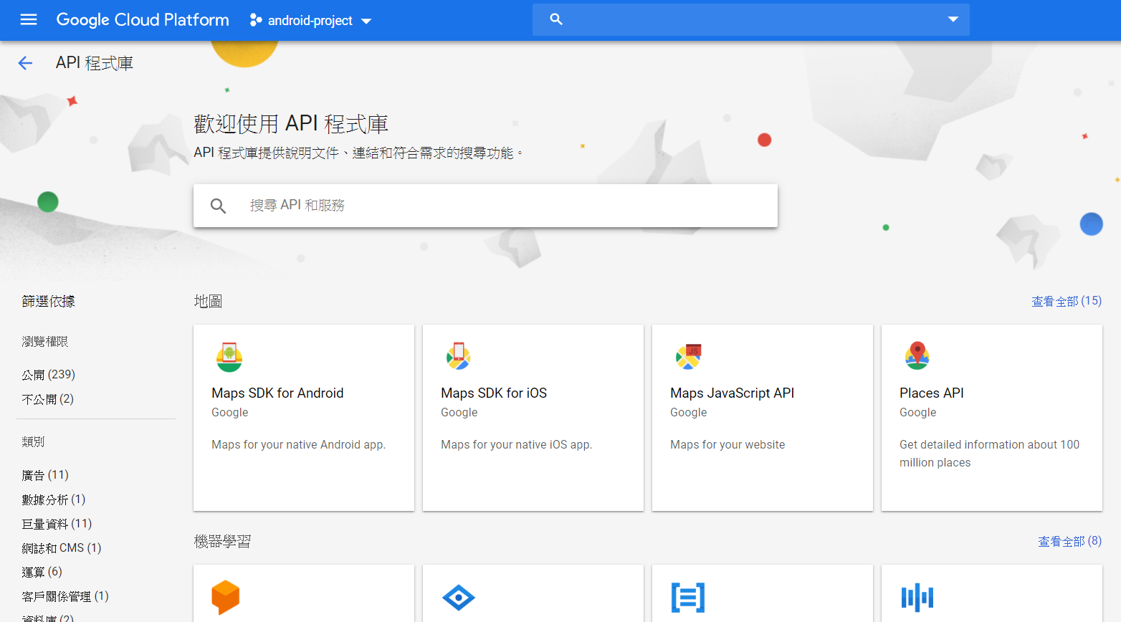
6. Enable Maps SDK for Android

Slide 13
Map UI
GoogleMap.uisettings.***

Slide 14
Gestures
Attribute
isTiltGesturesEnabled = boolean
isZoomGesturesEnabled = boolean
isRotateGesturesEnabled = boolean
isScrollGesturesEnabled = boolean
isScrollGesturesEnableedDuringRotateOrZoom = boolean
Method
setAllGesturesEnabled(boolean)
Notes:
isTiltGesturesEnabled: 是否允許手勢傾斜地圖
isZoomGesturesEnabled: 是否允許縮放地圖
isRotateGesturesEnabled: 是否允許旋轉地圖
isScrollGesturesEnabled: 是否允許拖曳地圖
isScrollGesturesEnableedDuringRotateOrZoom: 是否允許在旋轉或縮放時拖曳地圖
setAllGesturesEnabled() 如果要全開全關, 可以用這個方法

Slide 15
Marker

Slide 16

private fun addMarkerOnMap(bookmark: Bookmark) { val position = LatLng(bookmark.latitude, bookmark.longitude) val marker = map.addMarker(MarkerOptions() .position(position) .title(bookmark.name) .snippet(bookmark.comment) ) marker.tag = bookmark }

Slide 17
InfoWindow

Slide 18
class InfoWindowAdapter(val context: Activity) : GoogleMap.InfoWindowAdapter { private val contents: View init { contents = context.layoutInflater.inflate(R.layout.info_window_layout, null) } override fun getInfoContents(marker: Marker): View? { val bookmark = marker.tag as Bookmark val title = contents.findViewById<TextView>(R.id.txtPositionTitle) val snippet = contents.findViewById<TextView>(R.id.txtPositionSnippet) val image = contents.findViewById<ImageView>(R.id.imageView) title.text = bookmark.name snippet.text = bookmark.comment image.setImageBitmap(ImageUtils.loadBitmapFromFile(context, "${bookmark.placeId}.png")) return contents } override fun getInfoWindow(marker: Marker): View? { return null } }
Notes:
建立adapter
如果只用marker的部分屬性帶資料進來會不夠用，這時候可以善加利用tag屬性

Slide 19
// 修改InfoWindow排版 & InfoWindow點擊時的動作 map.setInfoWindowAdapter(InfoWindowAdapter(this)) map.setOnInfoWindowClickListener { it: Marker -> openForm(it.tag as Bookmark, false) }
private fun openForm(bookmark: Bookmark, isCreateMode: Boolean) { val intent = Intent(this, FormActivity::class.java) val bundle = Bundle() bundle.putBoolean("isCreateMode", isCreateMode) bundle.putParcelable("bookmark", bookmark) intent.putExtras(bundle) startActivity(intent) }
Notes:
在map中選擇要將地圖中的info window用哪一個adapter將UI串起來

Slide 20
Get POI Information
POI = point of interest

Slide 21
Get POI Basic Information
// 當地圖上POI被點取時，取得POI的基本資訊 map.setOnPoiClickListener { it:PointOfInterest -> //it.placeId //it.name //it.latLng
}

Slide 22
// 當地圖上POI被點取時，取得POI的基本資訊 map.setOnPoiClickListener { it:PointOfInterest -> //it.placeId //it.name //it.latLng GlobalScope.launch { val bookmark = bookmarkVM.findBookmarkByPlace(it.placeId) // 如果資料庫中有紀錄，則擷取資料庫的資料 if(bookmark != null){ openForm(bookmark, false) } else { // 透過place id取得更詳細的資料 // 這邊是打API的, 所以要注意網路是否有通 val request = FetchPlaceRequest.builder(it.placeId, capturePlaceFields).build() placesClient .fetchPlace(request) .addOnSuccessListener { val place = it.place if(!place.photoMetadatas.isNullOrEmpty()) { place.photoMetadatas!![0]?.apply { val requestPhoto = FetchPhotoRequest.builder(this) .setMaxHeight(270) .setMaxWidth(480) .build() placesClient.fetchPhoto(requestPhoto).addOnSuccessListener { val bookmark = Bookmark( id = 0, placeId = place.id, name = place.name, address = place.address, phone = place.phoneNumber, latitude = place.latLng!!.latitude, longitude = place.latLng!!.longitude, comment = "" ) bookmark.setImage(it.bitmap, applicationContext) openForm(bookmark, true) }.addOnFailureListener { e: Exception -> Log.e("easy.trip.debug", "Place not found: ${e.message}" ) } } } } .addOnFailureListener { Log.e("easy.trip.debug", "addOnFailureListener: ${it.message}" ) } } }
Get More Information
If has record, get data from database
Otherwise, get data from Place API
Request information of place
Request photo

Slide 23
1. Get data from database
GlobalScope.launch { val bookmark = bookmarkVM.findBookmarkByPlace(it.placeId) // 如果資料庫中有紀錄，則擷取資料庫的資料 if(bookmark != null){ openForm(bookmark, false) } else {
… …
}
… …
}

Slide 24
2-1. Request information of place
private lateinit var placesClient: PlacesClient private val capturePlaceFields = asList( Place.Field.ID, Place.Field.NAME, Place.Field.ADDRESS, Place.Field.PHONE_NUMBER, Place.Field.PHOTO_METADATAS, Place.Field.LAT_LNG )
val request = FetchPlaceRequest.builder(it.placeId, capturePlaceFields).build() placesClient.fetchPlace(request) .addOnSuccessListener {
… …
}
.addOnFailureListener { Log.e("easy.trip.debug", "addOnFailureListener: ${it.message}" ) }

Slide 25
2-2. Request photo
val place = it.place if(!place.photoMetadatas.isNullOrEmpty()) { place.photoMetadatas!![0]?.apply { val requestPhoto = FetchPhotoRequest.builder(this) .setMaxHeight(270).setMaxWidth(480).build() placesClient.fetchPhoto(requestPhoto)
.addOnSuccessListener { val bookmark = Bookmark( id = 0, placeId = place.id, name = place.name, address = place.address, phone = place.phoneNumber, latitude = place.latLng!!.latitude, longitude = place.latLng!!.longitude, comment = "" ) bookmark.setImage(it.bitmap, applicationContext) openForm(bookmark, true) }
.addOnFailureListener { e: Exception -> Log.e("easy.trip.debug", "Place not found: ${e.message}" ) } } }

Slide 26
Save bitmap to file

Slide 27
object ImageUtils { fun saveBitmapToFile(context: Context, bitmap: Bitmap, filename: String) { val inputStream = ByteArrayOutputStream() bitmap.compress(Bitmap.CompressFormat.PNG, 100, inputStream) val bytes = inputStream.toByteArray() val outputStream: FileOutputStream try { outputStream = context.openFileOutput(filename, Context.MODE_PRIVATE) outputStream.write(bytes) outputStream.close() Log.e("easy.trip.debug", "save image finish") } catch (e: Exception) { e.printStackTrace() } } fun loadBitmapFromFile(context: Context, filename: String): Bitmap? { val filePath = File(context.filesDir, filename).absolutePath return BitmapFactory.decodeFile(filePath) } }
Notes:
建立一個Utility，圖片的save & load

Slide 28
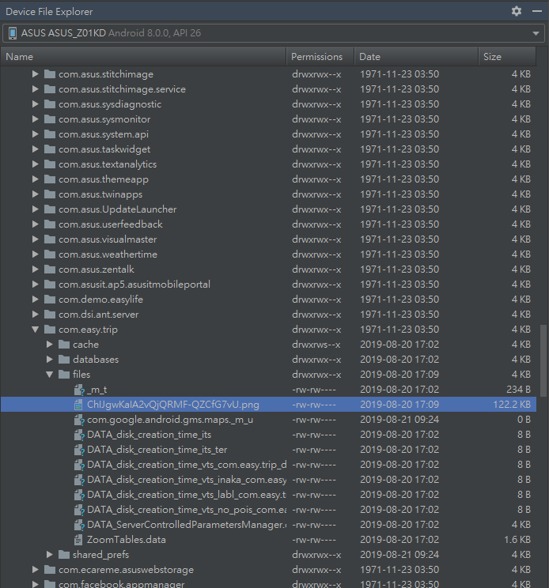
View file in APP
→ DeviceFileExploer
→ data
→ data
→ PACKAGE_NAME
→ files

